Slide 1
Deep Genomics
Tim Liu, 2021
https://timing.rbind.io
Notes:
https://creativecommons.org/licenses/by/4.0/

Slide 2
Outline
Overview of genomics
Construction of genetic score
Effectiveness of genetic score

Slide 3
Recap – David Ryan’s presentation

Slide 4
About me
Notes:
Made in China
Imported to Singapore for secondary school
Did research in wastewater recycling, neurogenetic diagnostics, and nanopore sequencing
Came to Cambridge, UK for undergraduate medicine and engineering
Working on human genomics with Hilary Martin at Sanger Institute:
Multi-omics association, rare disease diagnosis, polygenic risk score x epidemiology
National programme director at MedTech Foundation

Slide 5
Outline
Overview of genomics
Construction of genetic score
Effectiveness of genetic score

Slide 6
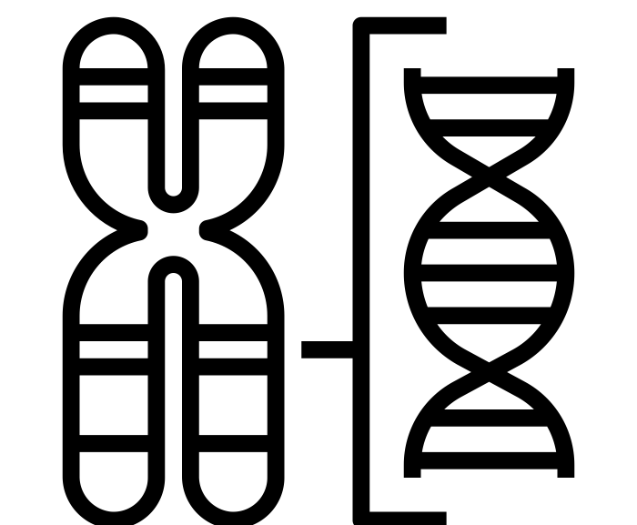
What is genomics
Genetics
Genomics

Slide 7
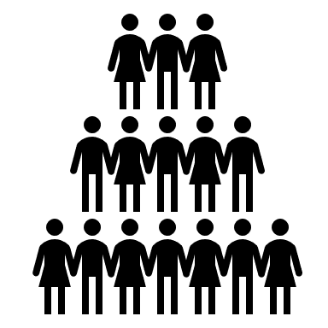
Why genomics
Clinical medicine
Genomics

Slide 8
Outline
Overview of genomics
Construction of genetic score
Effectiveness of genetic score

Slide 9
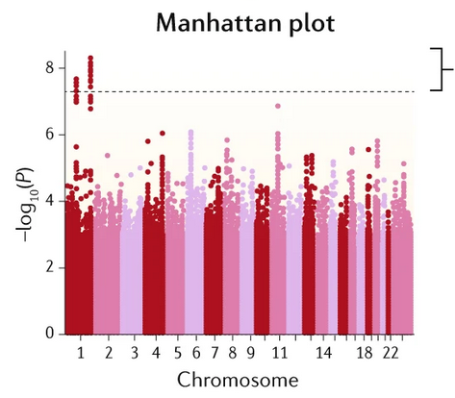
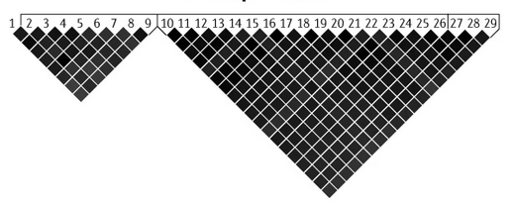
Genetic score
Definition
Association
Linkage disequilibrium
Notes:
https://www.nature.com/articles/s41576-018-0016-z/figures/1

Slide 10
Definition
Polygenic risk score

Slide 11
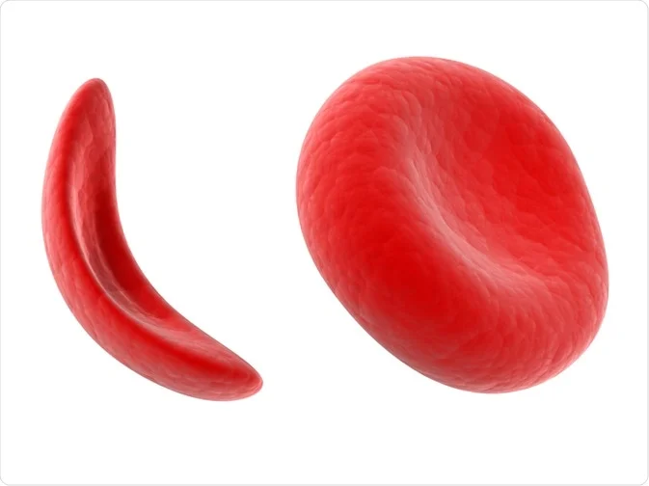
Definition
Polygenic risk score
Genetic score

Slide 12
Definition
Polygenic risk score
Genetic score

Slide 13
Definition
Polygenic risk score
Genetic score

Slide 14
Definition
Polygenic risk score
Genetic score

Slide 15
Definition
Polygenic risk score
Genetic score
1 0 0 0

Slide 16
Definition
Polygenic risk score
Poly
Genetic score
= Many genes
Example: schizophrenia

Slide 17
Definition
Polygenic risk score
Poly
Genetic score
Risk
Not diagnostic

Slide 18
Association
$$Y \sim s ∗ G+e$$

Slide 19
Association
$$Y \sim s ∗ G+e$$
Input
Y: vertical cup-disc ratio

Slide 20
Association
$$Y \sim s ∗ G+e$$
Input
Y: vertical cup-disc ratio
G = $\left[\begin{matrix}A \\ C \\ \begin{aligned}T \\ G\end{aligned}\end{matrix}\right],\text{∈ \{0, 1, 2\}}$

Slide 21
Association
$$Y \sim s ∗ G+e$$
Input
Output
Y: vertical cup-disc ratio
s: effect size
p: p value
e: error, modelled by BOLT-LMM
G = $\left[\begin{matrix}A \\ C \\ \begin{aligned}T \\ G\end{aligned}\end{matrix}\right],\text{∈ \{0, 1, 2\}}$

Slide 22
Association
$$Y \sim s ∗ G+e$$
Output
s: effect size
p: p value

Slide 23
Association
p: p value
Notes:
https://www.nature.com/articles/s41576-018-0016-z/figures/1

Slide 24
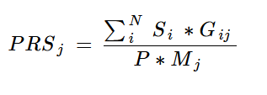
Association
p: p value
s: effect size

Slide 25
Association
Discovery population
p: p value
s: effect size
Test population

Slide 26
Linkage disequilibrium = correlation between variants r²

Slide 27
Linkage disequilibrium = correlation between variants r²
Parent
Child

Slide 28
Linkage disequilibrium = correlation between variants r²
Parent
Child

Slide 29
Linkage disequilibrium = correlation between variants r²
Parent
Child

Slide 30
Linkage disequilibrium = correlation between variants r²
Parent
Child

Slide 31
Linkage disequilibrium = correlation between variants r²
Parent
Child
Effect | S | p
No effect | 0.2 | 0.000000003
Protein-truncating | 0.3 | 0.000000001

Slide 32
Outline
Overview of genomics
Construction of genetic score
Effectiveness of genetic score

Slide 33
Effectiveness of genetic score
Determining factors
Evaluation of effectiveness
Combination with clinical data

Slide 34
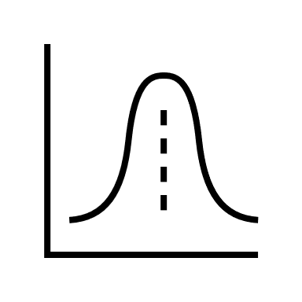
Factors determining effectiveness
Effect size distribution
(genetic architecture)
Sample size
Heritability

Slide 35
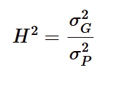
Heritability
What is heritability

Slide 36
Heritability
What is heritability

Slide 37
Heritability
Condition | Traits/subtypes | Heritability | Reference
Glaucoma | Intraocular pressure | 35-50% | Asefa et al. 2018
 | Vertical cup-to-disk ratio | 48-66% | Asefa et al. 2018
AMD | Early AMD | ~46% | Seddon et al. 2005
 | Late AMD | ~71% | Seddon et al. 2005
Alzheimer's |  | 60–80% | Cauwenberghe et al 2015

Slide 39
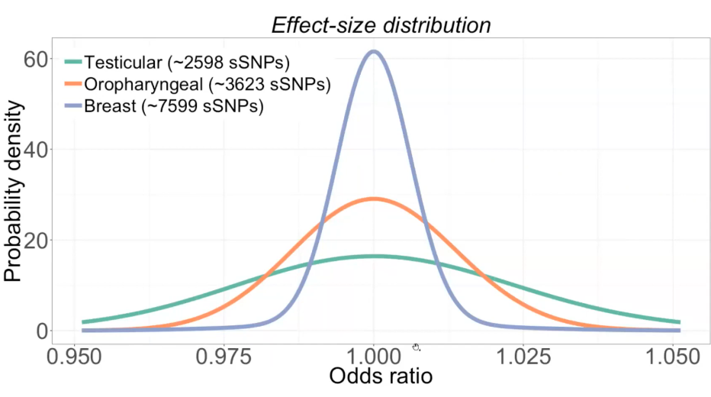
Effect size distribution
Notes:
https://www.nature.com/articles/s41467-020-16483-3

Slide 40
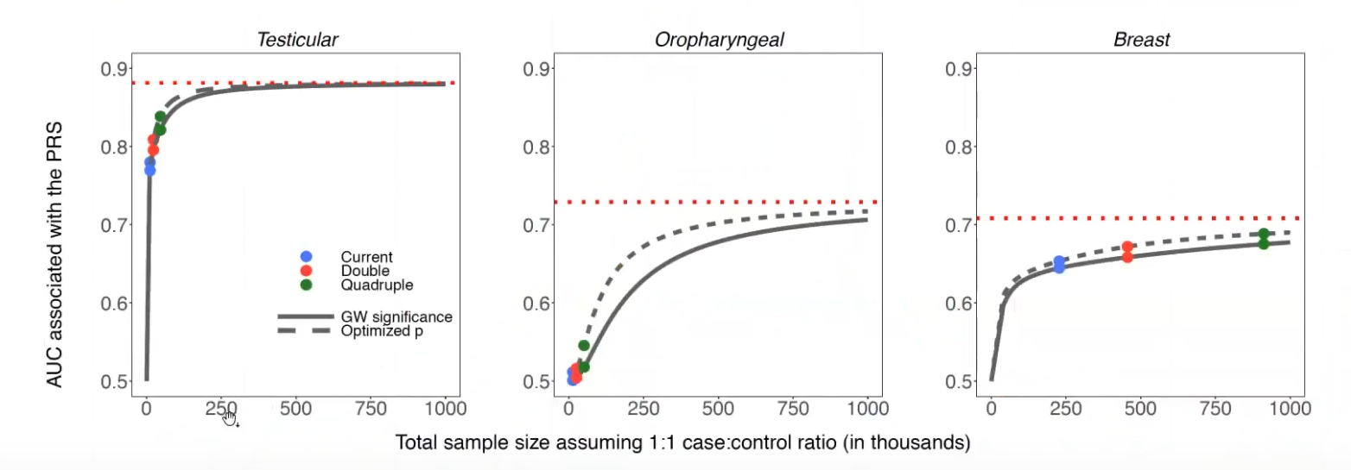
Sample size
Notes:
https://www.nature.com/articles/s41467-020-16483-3

Slide 41
Effectiveness of genetic score
Determining factors
Evaluation of effectiveness
Combination with clinical data

Slide 42
Evaluation of effectiveness
Notes:
https://www.nature.com/articles/s41588-019-0556-y?proof=t

Slide 43
Evaluation of effectiveness
Notes:
https://www.nature.com/articles/s41588-019-0556-y?proof=t

Slide 44
Evaluation of effectiveness
Notes:
https://www.nature.com/articles/s41588-019-0556-y?proof=t
https://pubmed.ncbi.nlm.nih.gov/27140283/

Slide 45
Effectiveness of genetic score
Determining factors
Evaluation of effectiveness
Combination with clinical data

Slide 46
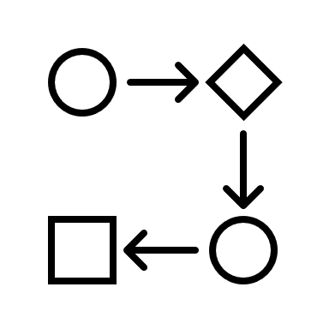
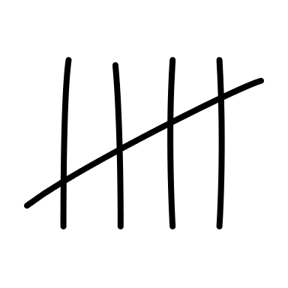
Combination with clinical data
What
How much
How

Slide 47
What
Predictive power
Disease prevention
Disease classification
Understand pathogenesis
Therapeutic targets
…

Slide 48
How
Study design
Implementation
Technical

Slide 49
How much
Polygenic score
Variant data
Sequencing data
prediction
sequencing
imaging
Notes:
https://ieeexplore.ieee.org/document/8103116

Slide 50
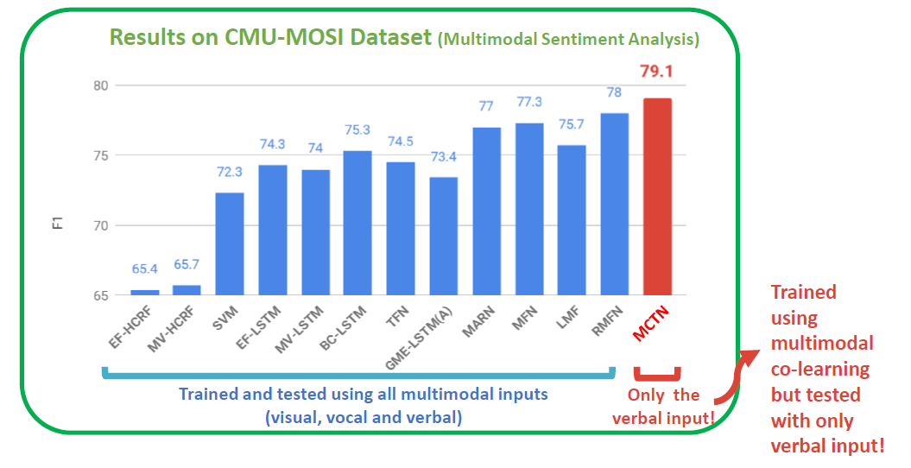
Co-learning
Notes:
https://cmu-multicomp-lab.github.io/mmml-course/

Slide 51
Acknowledgement
Xiao Liu
Siegfried Wagner
Pearse Keane
David Ryan
Anthony Khawaja
Hilary Martin
Qinqin Huang
Mihaela van der Schaar
David Chong
Samuel Chong

Slide 52
Resources
Advanced statistical genetics: EPI511 by Alkes Price
Deep learning for life sciences: https://mit6874.github.io/
Multimodal machine learning: https://cmu-multicomp-lab.github.io/mmml-course/
Genomics for social scientists: 20 hour long videos for a nice coverage of main concepts
Machine learning for healthcare
Broad Institute Medical/Population Genetics Primers
The G word podcast

