Slide 1
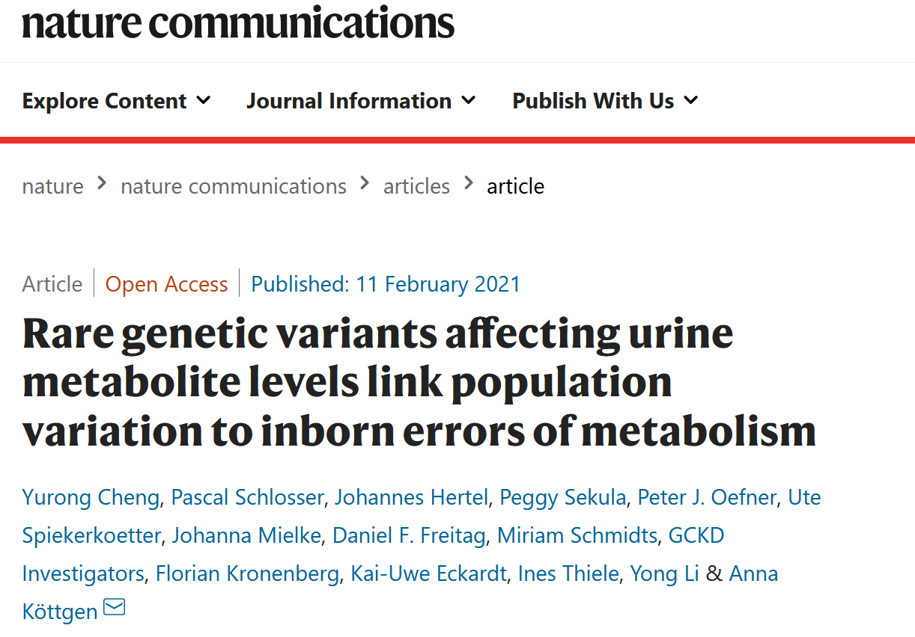

Slide 2
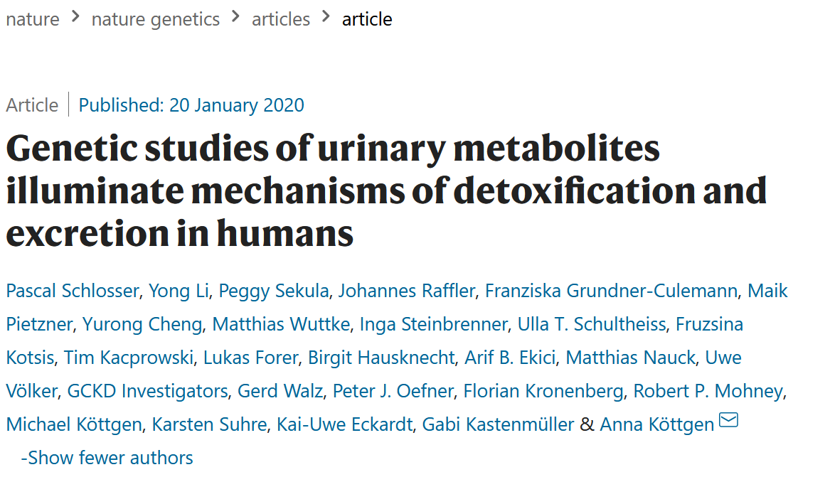
Context of the study
Most previous studies on rare variants and metabolite associations focus on blood metabolites
Effects of kidney handling of metabolites are not well captured
They previously published studies on common variants
The authors claim that kidney handling is only detectable when studying urine (Discussion)
I disagree because kidney also contributes to blood metabolite levels
E.g., failure to reabsorb one metabolite -> metabolite level decrease in the blood
It is difficult to tell metabolite handling without comparing the blood and urine metabolite level in the same person
Notes:
https://www.nature.com/articles/s41588-019-0567-8

Slide 3
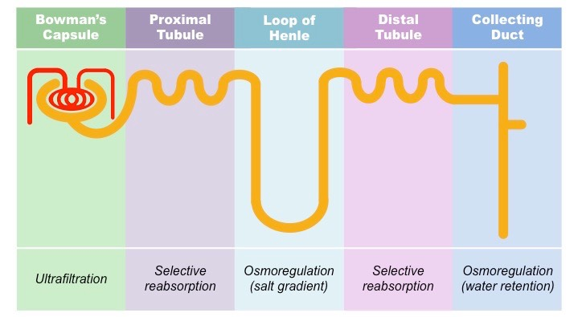
Physiology of the kidney
body expels everything that is small and hydrophobic enough and selectively choose what to take up. this is in contrast to a system where the body mostly secretes what it does not need, because it will not have transporters for toxins that it has not seen before. to make things more complicated, the kidney does actively secrete some chemicals

Slide 4
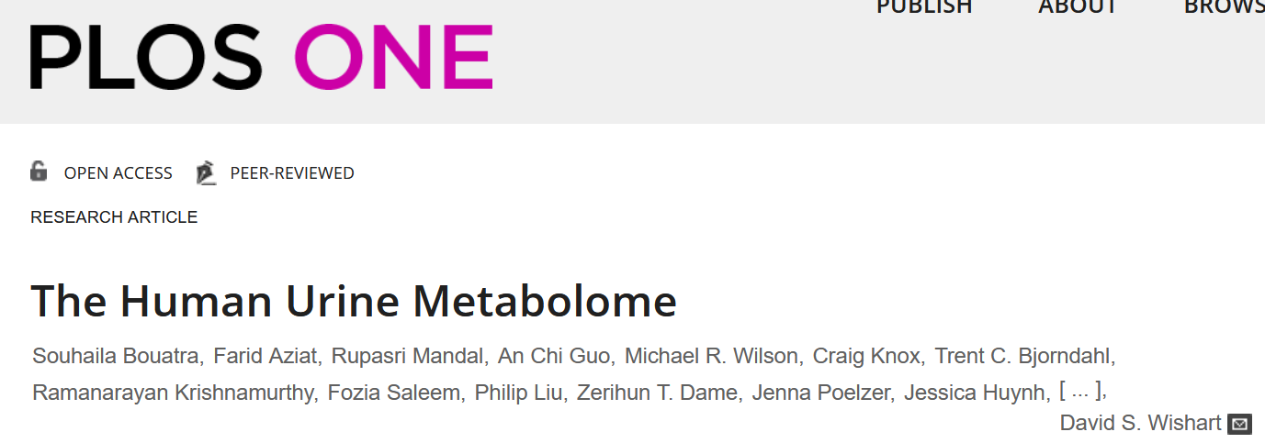
Metabolites in kidney
number of metabolites: Our data suggests that there are at least 3079 detectable metabolites in human urine, of which 1350 have been quantified. At least 72 of these compounds are of microbial origin, 1453 are endogenous while 2282 are considered exogenous (note some compounds can be both exogenous and endogenous), coming from diet, drugs, cosmetics or environmental exposure.
uniqueness compared with blood: The fact that so many compounds seem to be unique to urine likely has to do with the fact that the kidneys do an extraordinary job of concentrating certain metabolites from the blood. Consequently compounds that are far below the limit of detection in blood (using today’s instrumentation) are well above the detection limit in urine. In fact, concentration differences between the two biofluids sometimes exceed 1000X for certain compounds
Notes:
https://journals.plos.org/plosone/article?id=10.1371/journal.pone.0073076

Slide 5
Outline
Test
Significant associations (gene-based)
Effect size of variants in significant associations
Validate
Known genes causing inborn errors of metabolism
Validate in UK Biobank
Compare with organ and tissue-specific expressions
Gene ontology (pathways)
System biology models

Slide 6
Data
~4800 patients: moderate CKD (chronic kidney disease)
Metabolites from urine samples measured by Metabolon
1487 metabolites
53,714 ratios of fatty acids and amino acids
Genotype: 226,233 exome chip variants
MAF < 1%
Likely functional (splicing, nonsynonymous, stop gain, and stop loss) as in dbNSFP
Cumulative minor allele count >=10
Variants per gene >=2
Notes:
Patients: moderate CKD (chronic kidney disease)
Urine samples: Metabolon HD4 platform.
Genotyping was performed with the Illumina Omni2.5Exome Chip.

Slide 7
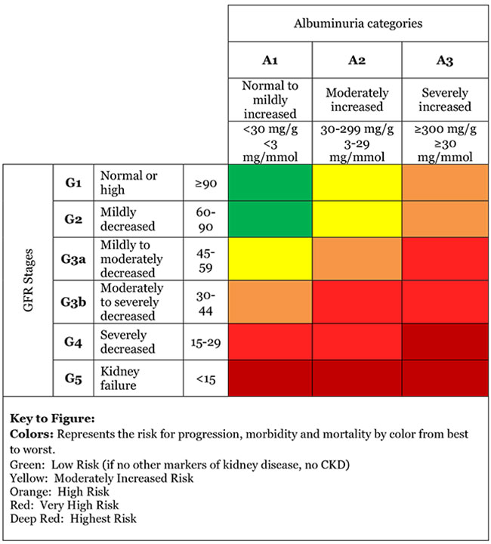
Tests
Types
burden test and sequence kernel association test (SKAT)
Threshold
Bonferroni correction and set at 1.46E−09 (single metabolites) and 4.02E-11 (ratios)
Further filtering for ratios: p-gain statistic:
Using the ratio should lower the p value by 5370k than the minimum of the p value of a single metabolite
Covariates
additive genetic model and adjusted for sex, age, Estimated Glomerular Filtration Rate (eGFR), Urine Albumin-to-Creatinine Ration, and principal components
Notes:
A burden test and the sequence kernel association test (SKAT) were carried out for each gene and each metabolite or metabolite ratio using the seqMeta R package (Methods). https://github.com/DavisBrian/seqMeta
We used an additive genetic model and adjusted for sex, age, eGFR, UACR, and principal components. Statistical significance was defined using a Bonferroni correction and set at 1.46E−09 (single metabolites) and 4.02E-11 (ratios).

Slide 8
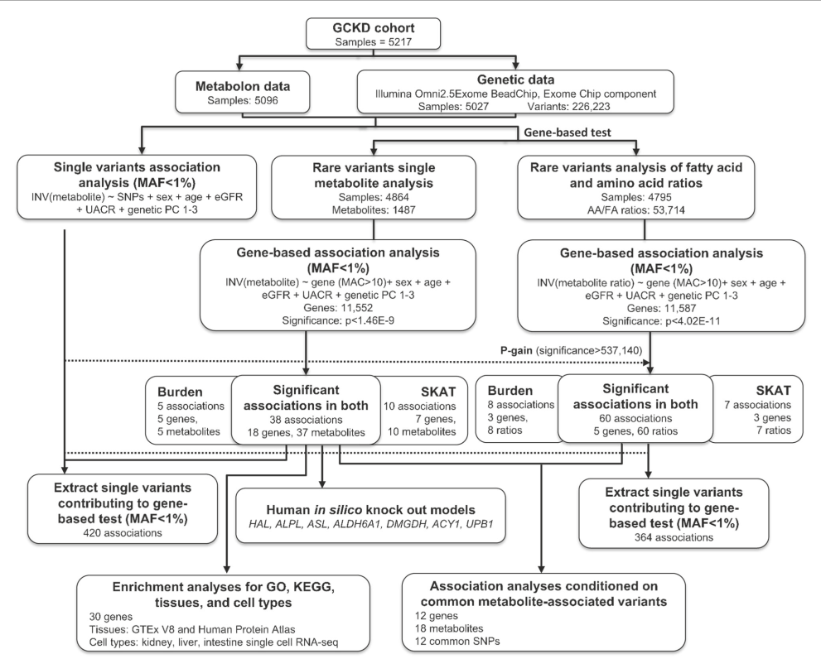
Notes:
Ratio results were further filtered by a p-gain of >537,140 to select ratios that carry information beyond its single metabolites (Methods).
The same model was applied to obtain single variant association results for the variants included in the gene-based tests.
In silico knockout models to validate findings were generated in a Virtual Metabolic Human.
Enrichment analyses of significant genes were carried out using GO terms, KEGG pathways, and gene expression data from tissues and cell types.
Conditional analyses were carried out to assess the effect of nearby common metabolite-associated variants on the findings from this study.

Slide 9
Critique
Why take the subsection of SKAT and Burden tests
Burden tests: all rare variants influence the phenotype in the same direction and with the same magnitude of effect
SKAT: some rare variants have effects, which can be in different directions with variable magnitudes
Combining both tests will make tests unnecessarily stringent

Slide 10
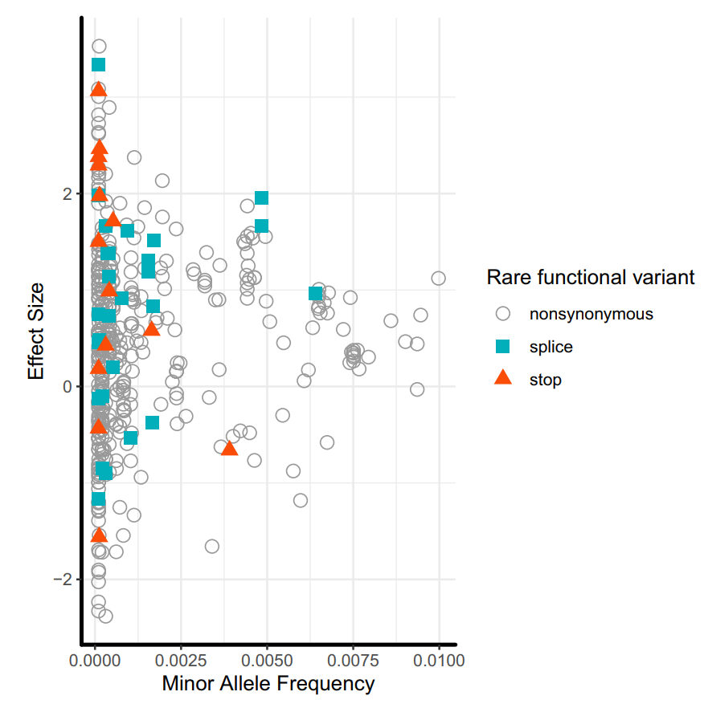
Test: Effect size of variants in significant associations: MAF
inverse normal transformed metabolite levels (in sd)
General trend
Smaller the MAF, larger the effect size
No difference across types of variants
Notes:
The symbols depict the effect of each variant that contributed to an aggregate association signal on the level of each significantly associated metabolite. Variants associated with more than one metabolite are therefore included for each metabolite because their associated effects can differ. The Y-axis represents the variants’ effects on inverse normal transformed metabolite levels; one unit represents one standard deviation. Color-coding and marker shape represent the consequence of 218 variants in the 26 metabolite-associated genes: white circle (nonsynonymous), cyan square (splice), orange triangle (stop-gain/loss).

Slide 11
Test: Effect size of variants in significant associations: variant location
Not all variants in a gene contribute to differentiating metabolite level

Slide 12
Test: Effect size of variants in significant associations: variant type

Slide 13
Critique and learning points
Different colours for each of the variant consequence would have made the point clearer
Would be interesting for me to investigate the metabolite ratio too
But I would probably just look at known metabolite relationships (gene sets) to avoid too much Bonferroni correction

Slide 14
Outline
Test
Significant associations (gene-based)
Effect size of variants in significant associations
Validate
Known genes causing inborn errors of metabolism
Validate in UK Biobank
Compare with organ and tissue-specific expressions
Gene ontology (pathways)
System biology models

Slide 15
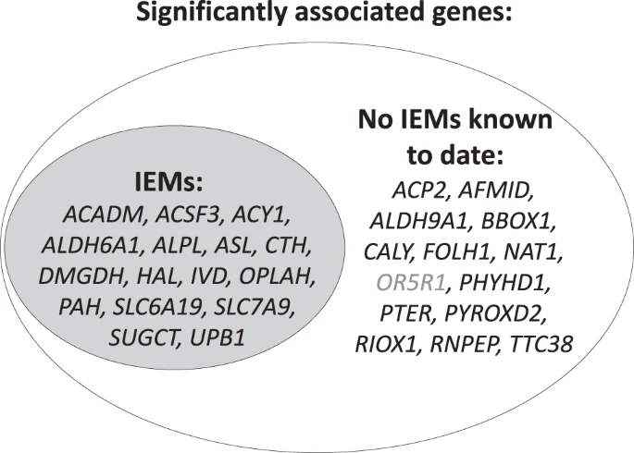
Validate: known genes causing inborn errors of metabolism (IEM)
16 out of 30 identified genes are known
The remaining 14 genes are also involved

Slide 16
Critique:
How about looking at the percentage of IEM genes that are not significant in the study
IEM
Significant

Slide 17
Validate: UK Biobank
Question: whether rare variants in the 30 identified genes are associated with diseases beyond IEMs
Able to validate a positive control but
No associations reached p value threshold after multiple testing correction
Reasons:
Associations with molecular intermediate phenotype can often be stronger than that with a complex disease

Slide 18
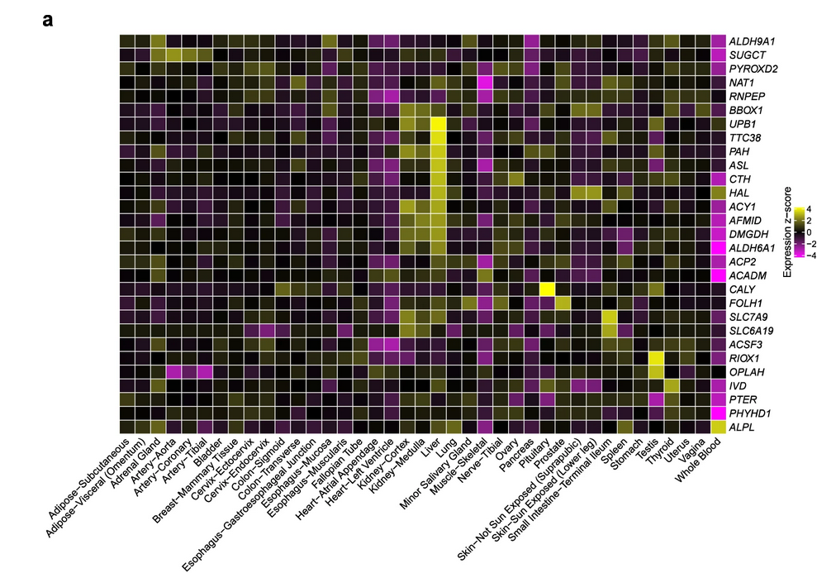
Validate: compare with organ and tissue-specific expressions

Slide 19
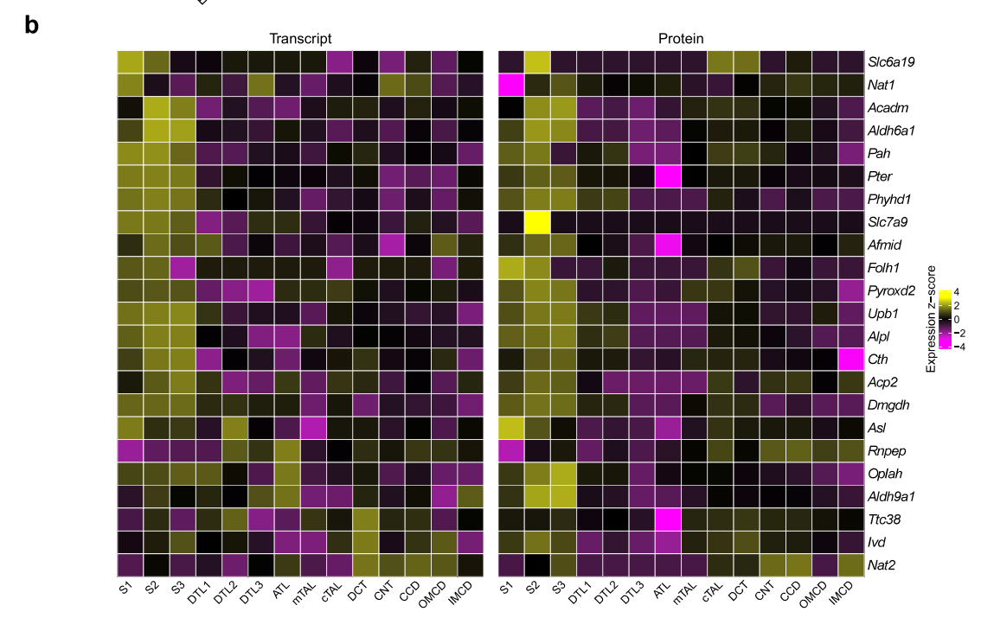

Slide 20
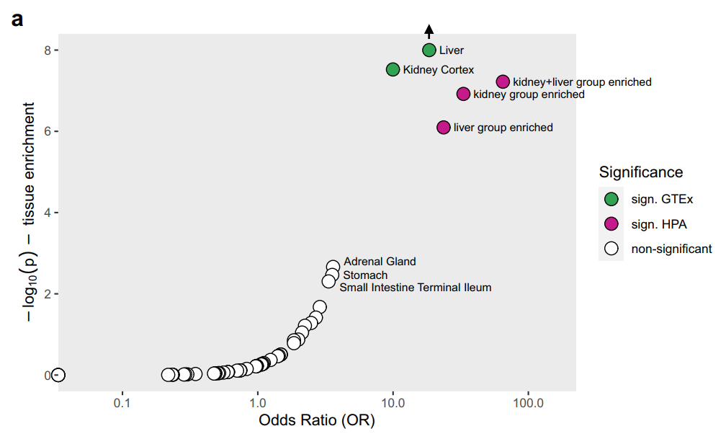
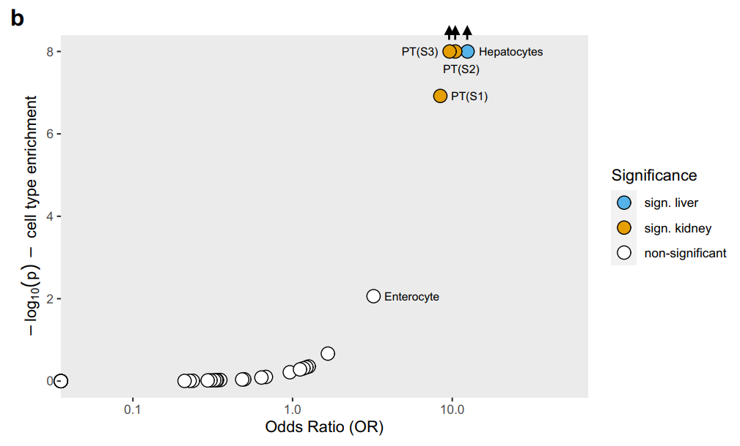
Validate: compare with tissue-specific expressions
Some genes show high expression only in specific renal tissue type, not when kidney is compared with other organs as a whole

Slide 21
Validate: Gene ontology (pathways)
Genes are enriched under processes that involves amino acids and other chemicals’ metabolism as well as enzymatic activities
Notes:
https://www.youtube.com/watch?v=HjRmQth8hbI

Slide 22
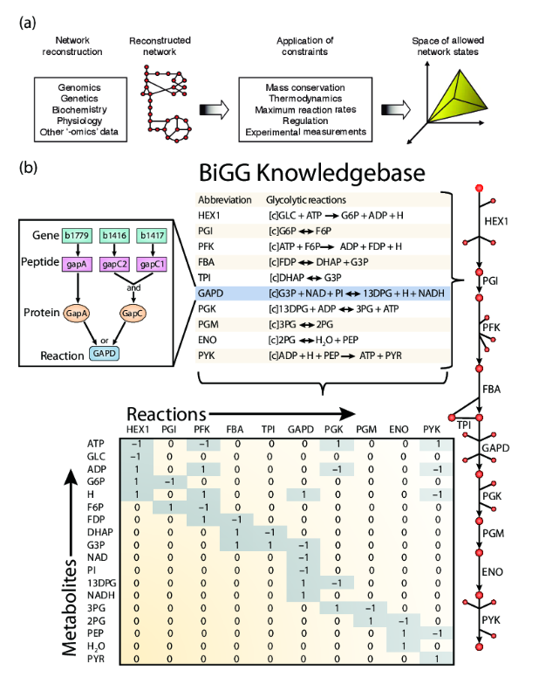
Validate: Virtual human model
Data required to derive thermodynamically feasible metabolism:
Genomic (including gene knockouts)
Biochemical
Physiological

Slide 23
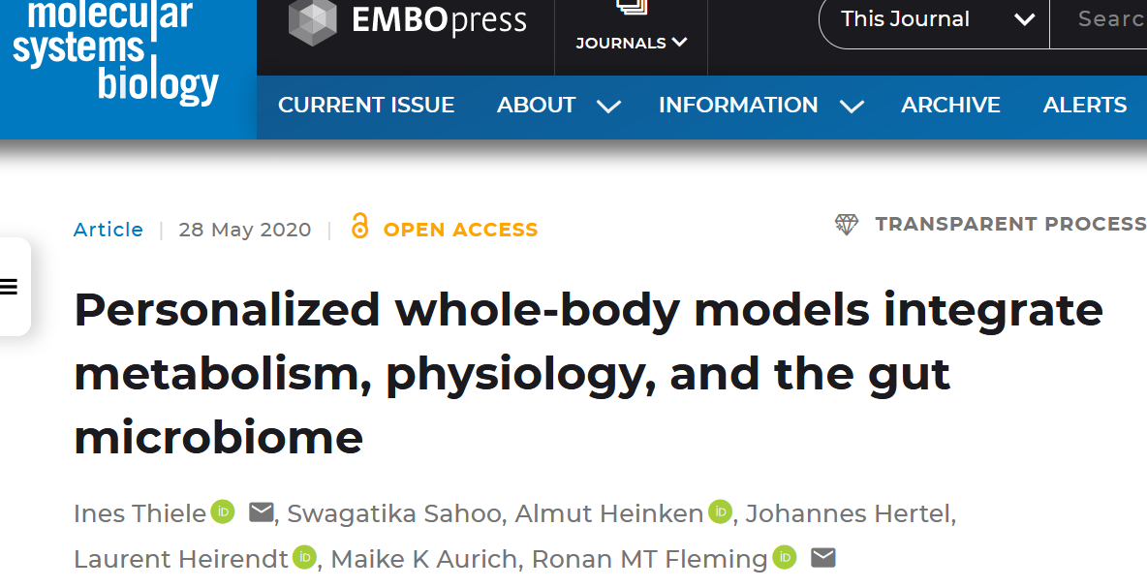
Validate: Virtual human model

Slide 24
Discussion
This paper used a few validation techniques that we can borrow
Could have done better for finding significant associations

